Slide 1
Why we Procrastinate?

Slide 2
What is Procrastination?
Not being able to bring ourselves to do the things we know we want to do
Decision - not to do you need to do now, but to do later instead

Slide 3
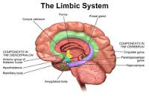
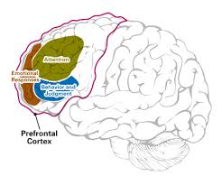
Why we procrastinate?
Limbic System vs Prefrontal Cortex

Slide 4
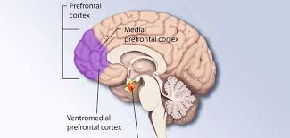
Prefrontal Cortex
WANTS TO WORK

Slide 5
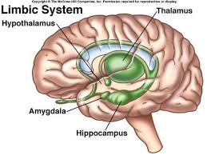
Limbic System
WANTS TO PLAY

Slide 6
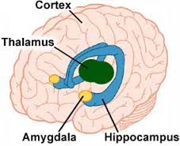
Why Limbic System Wins?
AMYGDALA

Slide 7
Threatening Stimuli
Not knowing where to start
Dreading the displeasure of doing task
A fear of failure

Slide 8
How to overcome???
METACOGNITION
Plan Goals
Plan Time
Plan Resources
Plan Process
Plan for distractions
Plan for failure

Slide 9


Slide 10
THANK YOU

